Slide 1
http://www.vidyanidhi.com/
ketkiacharya.net@gmail.com
Ketki Acharya
From: SM VITA ATC of CDAC
9769201036
ketkiacharya.net@gmail.com

Slide 2
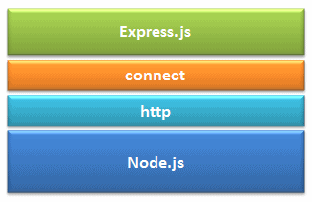
Express JS
Express.js is based on the Node.js middleware module called connect which in turn uses http module. So, any middleware which is based on connect will also work with Express.js.
Advantages of Express.js
Makes Node.js web application development fast and easy.
Easy to configure and customize.
Allows you to define routes of your application based on HTTP methods and URLs.
Includes various middleware modules which you can use to perform additional tasks on request and response.
Easy to integrate with different template engines like Jade, Vash, EJS etc.
Allows you to define an error handling middleware.
Easy to serve static files and resources of your application.
Allows you to create REST API server.
Easy to connect with databases such as MongoDB, Redis, MySQL

Slide 3
Express Overview
Express is a minimal and flexible Node.js web application framework that provides a robust set of features to develop web and mobile applications. It facilitates the rapid development of Node based Web applications. Following are some of the core features of Express framework −
Allows to set up middlewares to respond to HTTP Requests.
Defines a routing table which is used to perform different actions based on HTTP Method and URL.
Allows to dynamically render HTML Pages based on passing arguments to templates.
npm install express --save
The above command saves the installation locally in the node_modules directory and creates a directory express inside node_modules. You should install the following important modules along with express −
body-parser − This is a node.js middleware for handling JSON, Raw, Text and URL encoded form data.
cookie-parser − Parse Cookie header and populate req.cookies with an object keyed by the cookie names.
multer − This is a node.js middleware for handling multipart/form-data.
$ npm install body-parser --save
$ npm install cookie-parser --save
$ npm install multer --save

Slide 4
Demo1:Hello world Example.
Following is a very basic Express app which starts a server and listens on port 8081 for connection. This app responds with Hello World! for requests to the homepage. For every other path, it will respond with a 404 Not Found.
You will see the following output −
Example app listening at http://0.0.0.0:8081
Open http://127.0.0.1:8081/ in any browser to see the following result.
var express = require('express');
var app = express();
app.get('/', function (req, res) {
res.send('Hello World');
})
var server = app.listen(8081, function () {
var host = server.address().address
var port = server.address().port
console.log("Example app listening at http://%s:%s", host, port)
})
In the above example, we imported Express.js module using require() function.
The express module returns a function.
This function returns an object which can be used to configure Express application (app in the above example).
If the hostname is omitted, the server will accept connections on any IPv6 address (::) when IPv6 is available, or any IPv4 address (0.0.0.0) otherwise. A port value of zero will assign a random port. Or you can use 0:0:0:0:0:0:0:0, are reduced to ::
Let e=function(){}
Let demoe=e;
demoe();
or use
var server = app.listen(8081,”127.0.0.1” ,function () {

Slide 5
var host = server.address().address
Returns the bound address, the address family name, and port of the server as reported by the operating system if listening on an IP socket (useful to find which port was assigned when getting an OS-assigned address):{ port: 12346, family: 'IPv4', address: '127.0.0.1' }.

Slide 6
Demo:module returning function and function returning object.
// function_returnobj.js
exports function ()
{
return new Object();
}
// function_returnobj.js
exports.myfunction=function ()
{
return new Object();
}
//useit.js
var f=require("./function_returnobj");
var o=f();
console.log(o);
//useit.js
var f=require("./function_returnobj");
var o=f.myfunction();
console.log(o);

Slide 7
Request & Response
Express application uses a callback function whose parameters are request and response objects.
app.get('/', function (req, res) { // -- })
Request Object − The request object represents the HTTP request and has properties for the request query string, parameters, body, HTTP headers, and so on.
Response Object − The response object represents the HTTP response that an Express app sends when it gets an HTTP request.
You can print req and res objects which provide a lot of information related to HTTP request and response including cookies, sessions, URL, etc.

Slide 8
Basic Routing
We have seen a basic application which serves HTTP request for the dac.html . Routing refers to determining how an application responds to a client request to a particular endpoint, which is a URI (or path) and a specific HTTP request method (GET, POST, and so on).
var express = require('express');
var app = express();
// This responds with "Hello World" on the homepage
app.get('/', function (req, res) {
console.log("Got a GET request for the homepage");
res.send('Hello GET');
})
// This responds a POST request for the homepage
app.post('/', function (req, res) {
console.log("Got a POST request for the homepage");
res.send('Hello POST');
})
// This responds a DELETE request for the /del_user page.
app.delete('/del_user', function (req, res) {
console.log("Got a DELETE request for /del_user");
res.send('Hello DELETE');
})
// This responds a GET request for the /list_user page.
app.get('/list_user', function (req, res) {
console.log("Got a GET request for /list_user");
res.send('Page Listing');
})
// This responds a GET request for abcd, abxcd, ab123cd, and so on
app.get('/ab*cd', function(req, res) {
console.log("Got a GET request for /ab*cd");
res.send('Page Pattern Match');
})
var server = app.listen(8081,”127.0.0.1”, function () {
var host = server.address().address
var port = server.address().port
console.log("Example app listening at http://%s:%s", host, port)
})

Slide 9
Reading static file
Express provides a built-in middleware express.static to serve static files, such as images, CSS, JavaScript, etc.
You simply need to pass the name of the directory where you keep your static assets, to the express.static middleware to start serving the files directly. For example, if you keep your images, CSS, and JavaScript files in a directory named public, you can do this −
app.use(express.static('public')); We will keep a few images in public/images sub-directory as follows −
node_modules
server.js
public/
public/images
public/images/logo.png
root directory from which to serve static assets. The function determines the file to serve by combining req.url with the provided root directory. When a file is not found, instead of sending a 404 response, it calls next() to move on to the next middleware, allowing for stacking and fall-backs.

Slide 10
How to run -In browser :http://localhost:8081/Images/circ.bmp
var express = require('express');
var app = express();
app.use(express.static('public'));
app.get('/', function (req, res) {
res.send('Hello World');
})
var server = app.listen(8081, function () {
var host = server.address().address
var port = server.address().port
console.log("Example app listening at http://%s:%s", host, port)
})
In comd: node filename.js
This will start server

Slide 11
Using Get Method Submit Form detail to Server
Here is a simple example which passes two values using HTML FORM GET method. We are going to use process_get router inside server.js to handle this input.
<html>
<body>
<form action = "http://127.0.0.1:8081/process_get" method = "GET">
First Name: <input type = "text" name = "first_name"> <br>
Last Name: <input type = "text" name = "last_name">
<input type = "submit" value = "Submit">
</form>
</body>
</html>
in URL :http://localhost:8081/process_get
To run code type on cmd> node 05server_post.js
and in url :http://localhost:8081/04get_form.html
In this example when clint click on submit it will listen to action so control will go to
http://127.0.0.1:8081/process_get
Method which is written in [server] code

Slide 12
var express = require('express');
var app = express();
app.use(express.static('public'));
app.get('/ getform', function (req, res) {
res.sendFile( __dirname + "/" + "04get_form.html" );
})
app.get('/process_get', function (req, res) {
// Prepare output in JSON format
response = {
first_name:req.query.first_name,
last_name:req.query.last_name
};
console.log(response);
res.end(JSON.stringify(response));
}) var server = app.listen(8081, function () {
var host = server.address().address
var port = server.address().port
console.log("Example app listening at http://%s:%s", host, port)
})
Type in URL :http://localhost:8081/04get_form.html
in URL :http://localhost:8081/process_get
__dirname is an environment variable that tells you the absolute path of the directory containing the currently executing file.
The __dirname variable always returns the absolute path of where your files live.

Slide 13
Using Post Method Submit Form detail to Server
Here is a simple example which passes two values using HTML FORM POST method. We are going to use process_get router inside server.js to handle this input.
<html>
<body>
<form action = "http://127.0.0.1:8081/process_post" method = "POST">
First Name: <input type = "text" name = "first_name"> <br>
Last Name: <input type = "text" name = "last_name">
<input type = "submit" value = "Submit">
</form>
</body>
</html>
Create application/x-www-form-urlencoded parser

Slide 14
var express = require('express');
var app = express();
var bodyParser = require('body-parser');
// Create application/x-www-form-urlencoded parser
var urlencodedParser = bodyParser.urlencoded({ extended: false })
app.use(express.static('public’));
app.use(express.urlencoded({ extended: false }));
app.get(‘/postdata', function (req, res) {
res.sendFile( __dirname + "/" + "05post_form.html" );
})
app.post('/process_post', urlencodedParser, function (req, res) {
// Prepare output in JSON format
response = {
first_name:req.body.first_name,
last_name:req.body.last_name
};
console.log(response);
res.end(JSON.stringify(response));
}) var server = app.listen(8081, function () {
var host = server.address().address
var port = server.address().port
console.log("Example app listening at http://%s:%s", host, port)
})
What is Middleware?
It is those methods/functions/operations that are called BETWEEN processing the Request and sending the Response in your application method.
App.use()
Middle ware
2. You nedd
express.urlencoded() for POST and PUT requests, because in both these requests you are sending data (in the form of some data object) to the server and you are asking the server to accept or store that data (object), which is enclosed in the body (i.e. req.body) of that (POST or PUT) Request
const { first_name, last_name } = req.body;
express.urlencoded() is a method inbuilt in express to recognize the incoming Request Object as strings or arrays. This method is called as a middleware in your application using the code: app.use(express.urlencoded());

Slide 15
var express = require('express');
var app = express();
// Create application/x-www-form-urlencoded parser
app.use(express.static('public’));
app.use(express.urlencoded({ extended: false }));
app.get(‘/postdata', function (req, res) {
res.sendFile( __dirname + "/" + "05post_form.html" );
})
app.post('/process_post', function (req, res) {
// Prepare output in JSON format
response = {
first_name:req.body.first_name,
last_name:req.body.last_name
};
console.log(response);
res.end(JSON.stringify(response));
}) var server = app.listen(8081, function () {
var host = server.address().address
var port = server.address().port
console.log("Example app listening at http://%s:%s", host, port)
})
What is Middleware?
It is those methods/functions/operations that are called BETWEEN processing the Request and sending the Response in your application method.
App.use()
Middle ware
2. You nedd
express.urlencoded() for POST and PUT requests, because in both these requests you are sending data (in the form of some data object) to the server and you are asking the server to accept or store that data (object), which is enclosed in the body (i.e. req.body) of that (POST or PUT) Request
const { first_name, last_name } = req.body;
express.urlencoded() is a method inbuilt in express to recognize the incoming Request Object as strings or arrays. This method is called as a middleware in your application using the code: app.use(express.urlencoded());

Slide 16
bodyParser.urlencoded([options])
Returns middleware that only parses urlencoded bodies and only looks at requests where the Content-Type header matches the type option. This parser accepts only UTF-8 encoding of the body and supports automatic inflation of gzip and deflate encodings.
A new body object containing the parsed data is populated on the request object after the middleware (i.e. req.body). This object will contain key-value pairs, where the value can be a string or array (when extended is false), or any type (when extended is true).
Options
The urlencoded function takes an optional options object that may contain any of the following keys:
extended
The extended option allows to choose between parsing the URL-encoded data with the querystring library (when false) or the qs library (when true). The "extended" syntax allows for rich objects and arrays to be encoded into the URL-encoded format, allowing for a JSON-like experience with URL-encoded. For more information, please see the qs library.
Defaults to true, but using the default has been deprecated.
extended: true, then you can parse nested objects, or generally any type. However, if you set extended: false, then you can only parse strings or arrays. But what does ...
https://github.com/expressjs/body-parser#bodyparserurlencodedoptions

Slide 17
app.use(BodyParser.json());
It looks at requests where the Content-Type: application/json header is present and transforms the text-based JSON input into JS-accessible variables under req.body.
app.use(bp.urlencoded({extended: true}) does the same for URL-encoded requests.
the extended: true precises that the req.body object will contain values of any type instead of just string
app.use(bodyParser.json()) basically tells the system that you want json to be used.
bodyParser.urlencoded({extended: ...})
basically tells the system whether you want to use a simple algorithm for shallow parsing (i.e. false) or complex algorithm for deep parsing that can deal with nested objects (i.e. true).
URL encoding and JSON encoding both allow to convert a (nested) object to string, but the format is different. An URL encoded string is in general not a valid JSON string.

Slide 18
const express = require('express');
const bodyParser = require('body-parser');
const app = express();
const PORT = 3000;
// Middleware to parse JSON
app.use(bodyParser.json());
app.post('/echo', (req, res) => {
console.log('Received JSON:', req.body);
// Sending back the same JSON data
res.json(req.body);
});
app.listen(PORT, () => {
console.log(`Server running on http://localhost:${PORT}`);
});

Slide 19
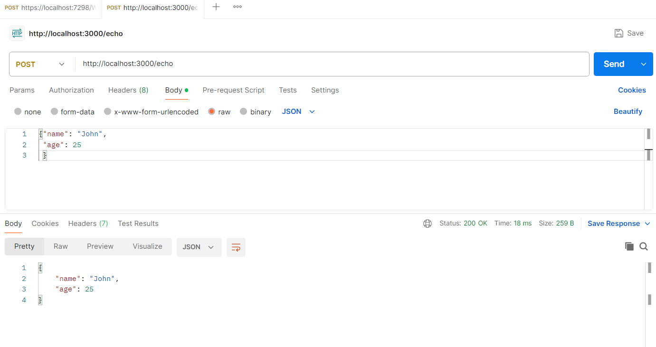

Slide 20
Client Browser
Wwwroot
Public folder
Js
Css
Static index.html
Src folder
JSX
JS
PHP
ASP
HSP
engine

